Slide 1

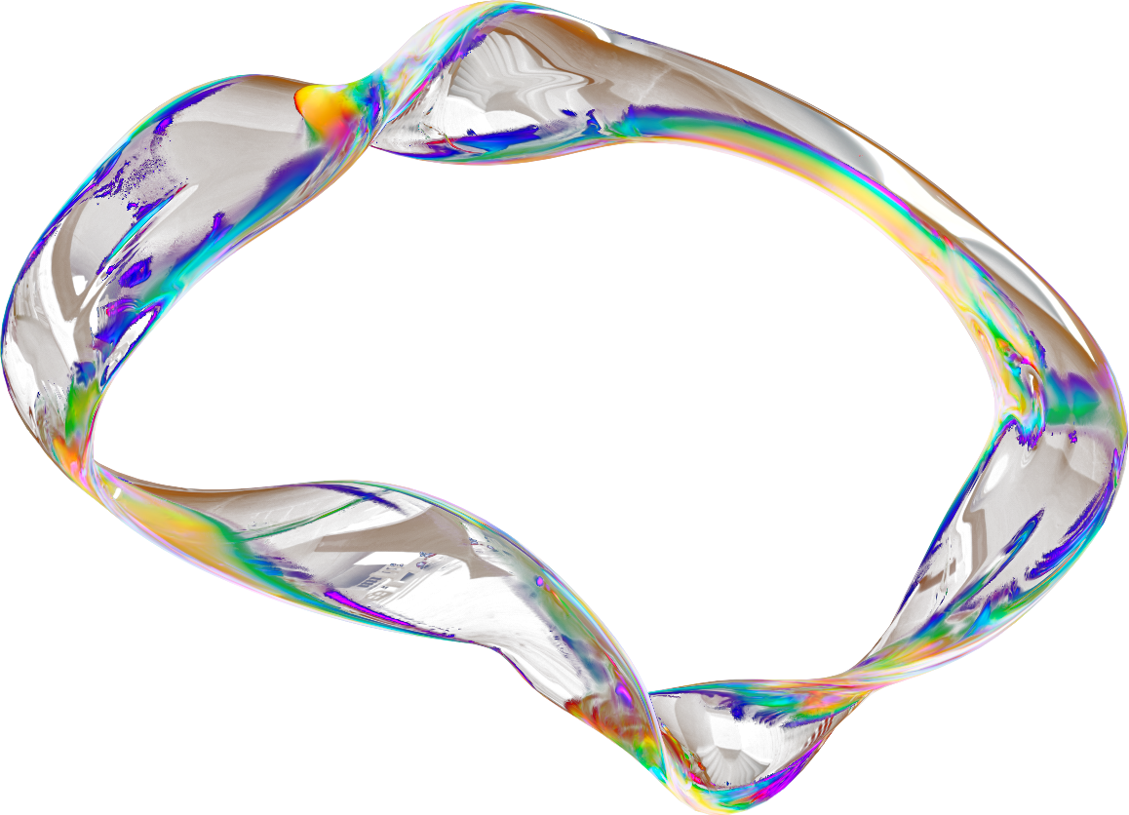
Github Repository
SPATIO-TEMPORAL TRAFFIC FLOW PREDICTION USING DCRNN
Vaishnavi Kamdi
G48986897
CSCI 6365-80 Advanced Machine Learning
Traffic Flow Forecasting using
Diffusion Convolutional Recurrent Neural Network

Slide 2

  Problem: Predict traffic speeds 1 hour ahead across 325 sensors
  Challenge: Complex spatio-temporal dependencies
    Spatial: Traffic at one location affects neighbors
    Temporal: Patterns change over time (rush hours, weekends)
  Solution: DCRNN - Combines Graph Neural Networks + RNN
PROBLEM STATEMENT

Slide 3
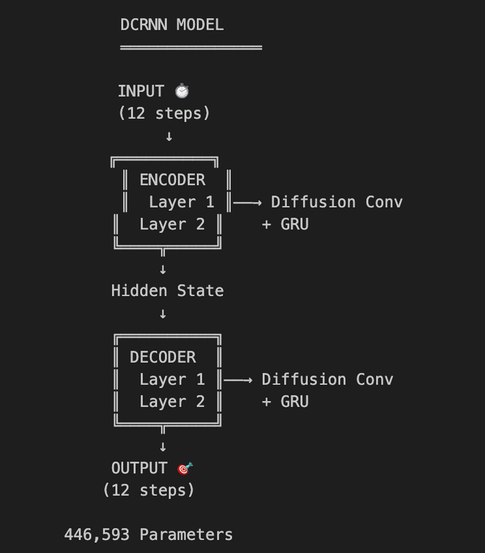
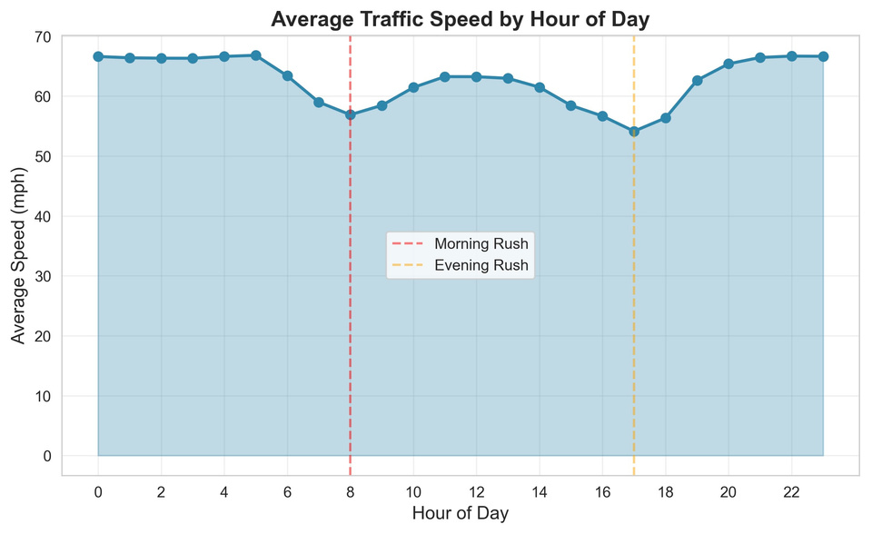
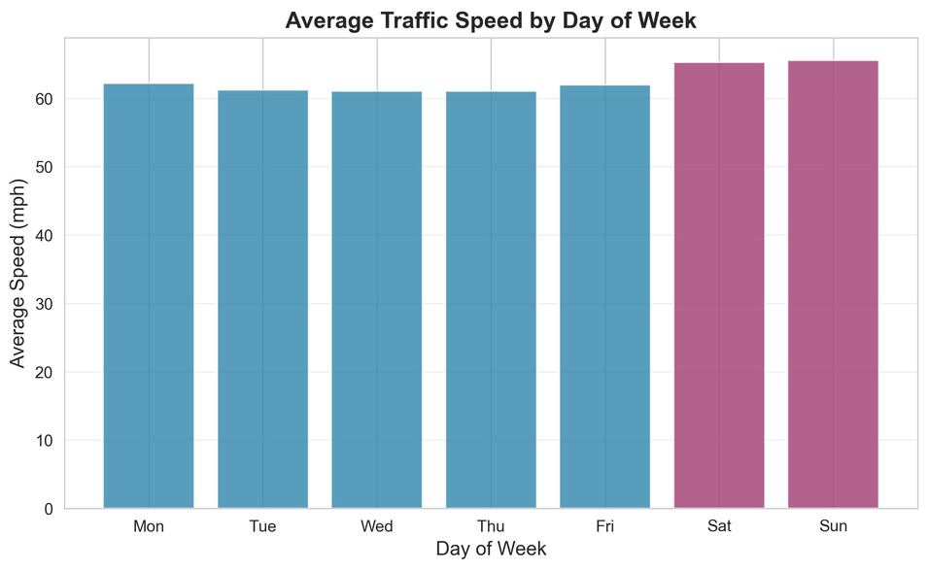
DATA AND MODEL
PEMS-BAY Dataset:
DCRNN Architecture:
  325 sensors, San Francisco Bay Area
  6 months (52,116 timesteps at 5-min intervals)
  Split: 70% train / 15% val / 15% test

Slide 4
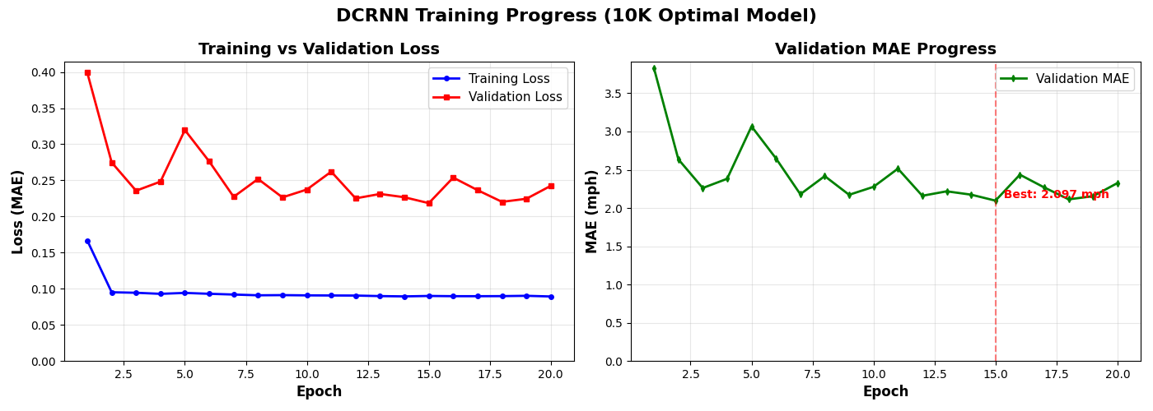
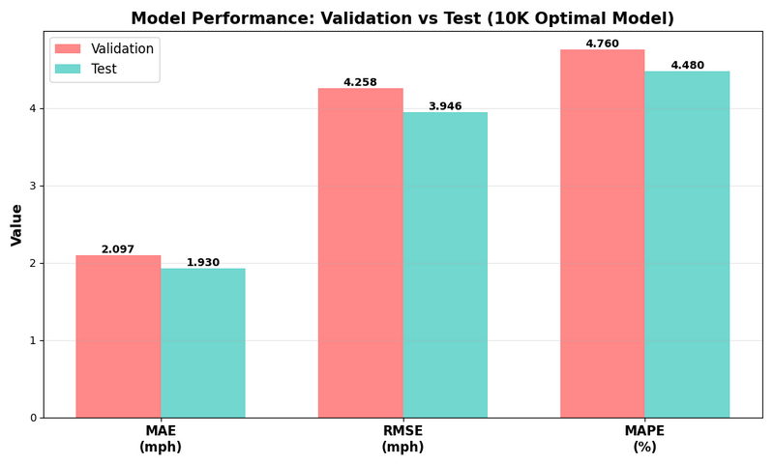

RESULTS
PERFORMANCE CONTEXT
  Our DCRNN: 1.930 mph MAE
  Original Paper: ~2-3 mph (typical)
  Historical Average: ~8 mph
  77.5% better than naive!
Multi-Horizon Performance:
  15 min ahead: 1.64 mph MAE
  30 min ahead: 1.93 mph MAE
  60 min ahead: 2.18 mph MAE
KEY ACHIEVEMENTS:
  Excellent Generalization: Test (1.93) < Validation (2.10) mph
→ No overfitting!
  Stable Long-term Forecasts: Only +0.54 mph degradation (15→60 min)
→ Reliable hour-ahead predictions
  Production-Ready Accuracy: Sub-2 mph error across 325 sensors
→ Real-world deployment ready
Metric | Test Result
MAE | 1.930 mph
RMSE | 3.946 mph
MAPE | 4.48%

Slide 5
DASHBOARD FEATURES
TAB 1: NETWORK OVERVIEW
  Interactive map of all 325 sensors
  Color-coded by current speed/prediction
  Network-wide statistics (avg speed, active sensors)
  Real-time prediction accuracy metrics
→ Get the big picture at a glance
TAB 2: SENSOR DETAILS
  Select any sensor for deep analysis
  Multi-horizon predictions (5, 15, 30, 45, 60 min)
  Historical vs predicted speeds (time series)
  Performance metrics (MAE, RMSE, MAPE) per sensor
→ Detailed individual sensor analysis
TAB 3: COMPARISON VIEW
  Side-by-side comparison (up to 4 sensors)
  Identify spatial correlations & patterns
  Peak hour analysis & traffic flow
  Custom time range filtering
→ Understand sensor relationships

Slide 6
THANK YOU
for your time and attention!

